Slide 1
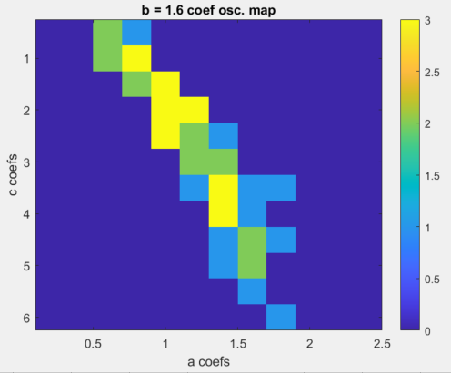
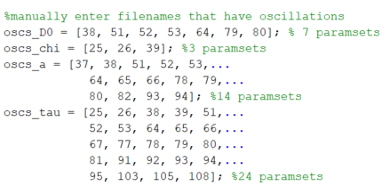
“True" oscillations

Slide 2
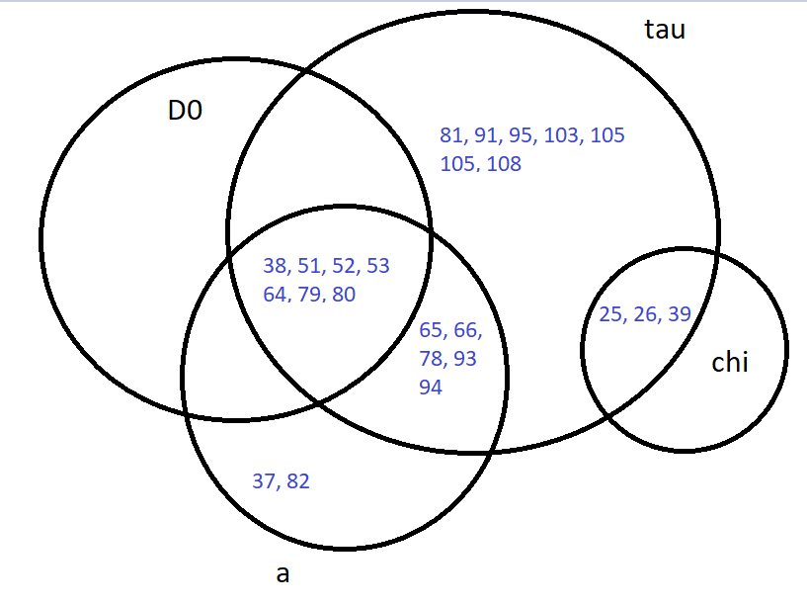
Single gene oscillations in ‘a’ and ‘tau’
Maximum number of co-oscillations is 3 (‘tau’, ‘D0’, ‘a’)
Consistent pairs of gene oscillations:
‘chi’ and ‘tau’
‘a’ and ‘tau’

Slide 3
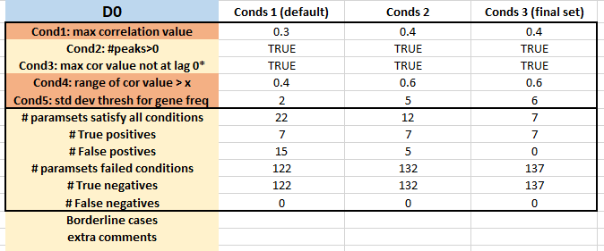
Finding conditions that select D0 gene oscillations

Slide 4
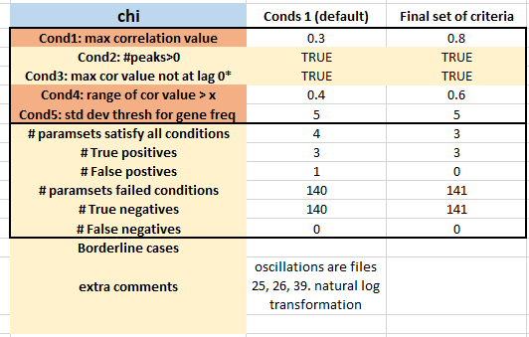
Finding conditions that select chi gene oscillations

Slide 5
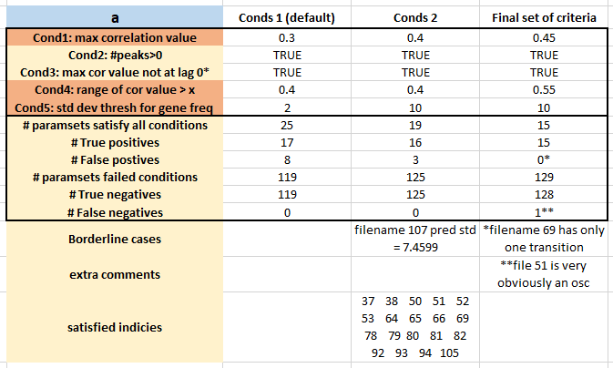
Finding conditions that select a gene oscillations

Slide 6
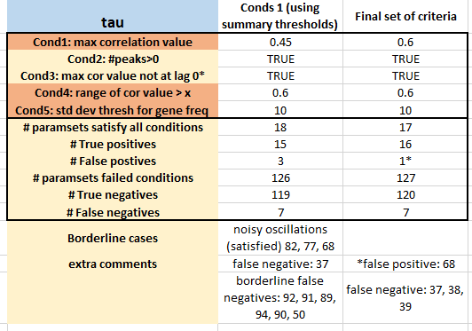
Finding conditions that select tau gene oscillations

Slide 7
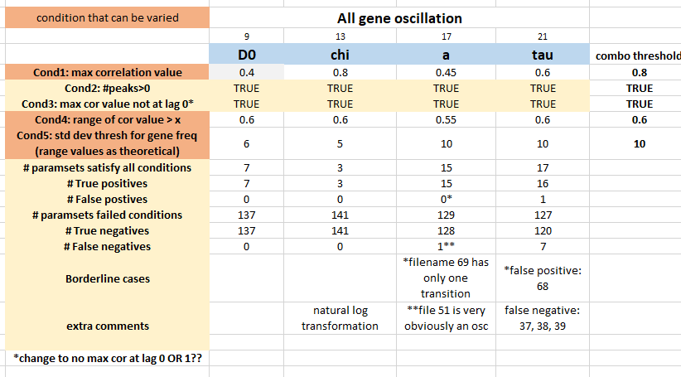
Summary of conditions that select for oscillations

Slide 8
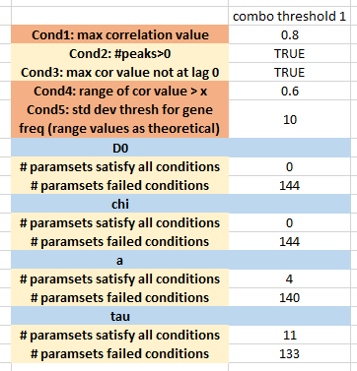
Stringent thresholds are too stringent!!!!!

Slide 9
Trying less stringent threshold values

Slide 10
Finding conditions that select D0 gene oscillations (doesn’t need to change)

Slide 11
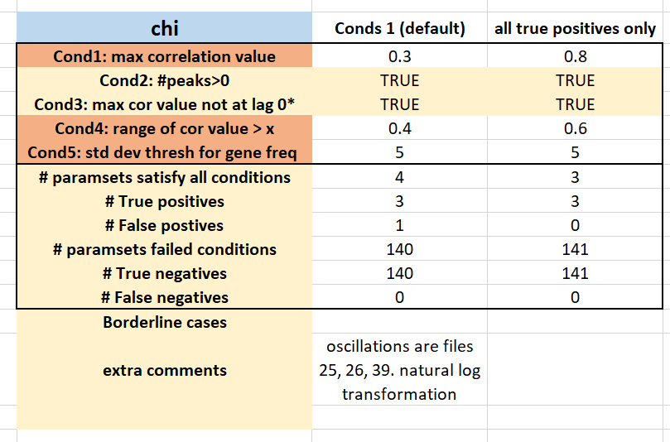
Finding conditions that select chi gene oscillations (conds 1 used in summary conditions – 3 slides ahead)

Slide 12
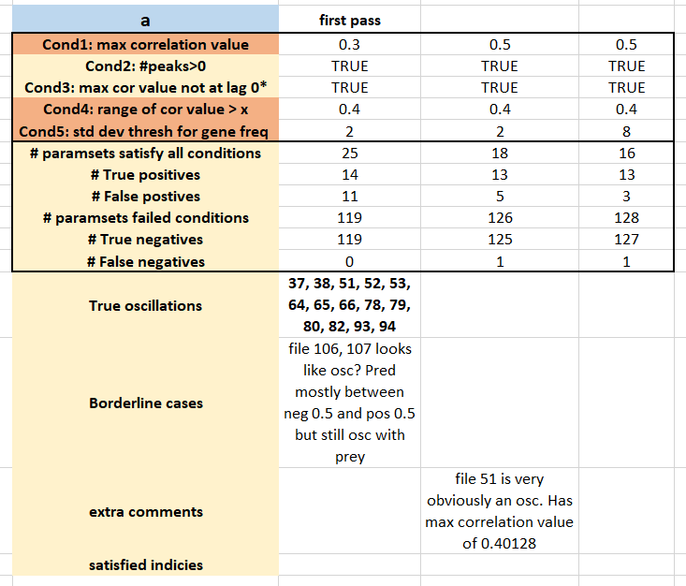

Slide 13
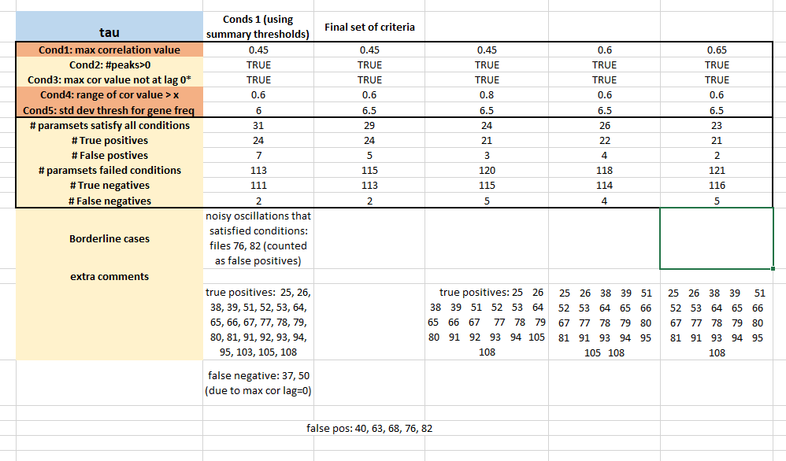

Slide 14
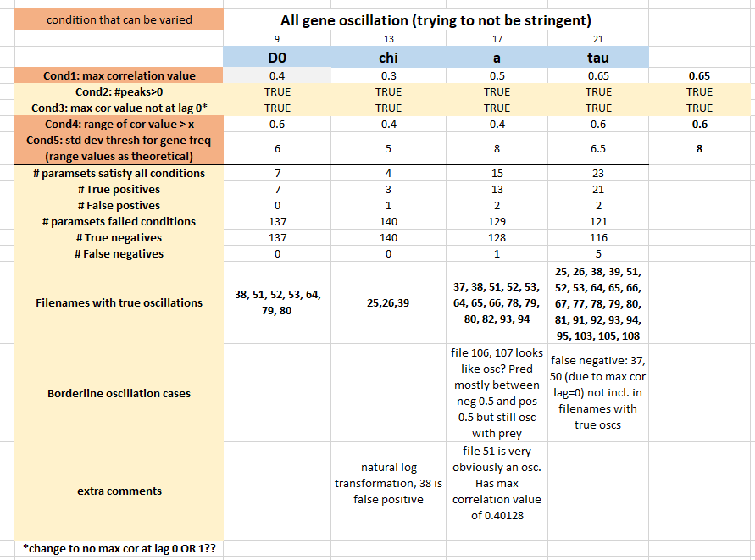

Slide 15
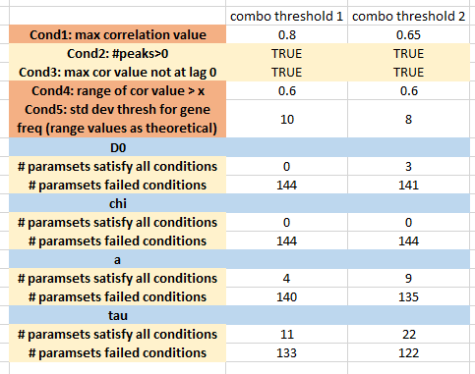
Even the more generous thresholds completely exclude chi oscillations

Slide 16
Single genes oscillations:
(there aren’t any)

Slide 17
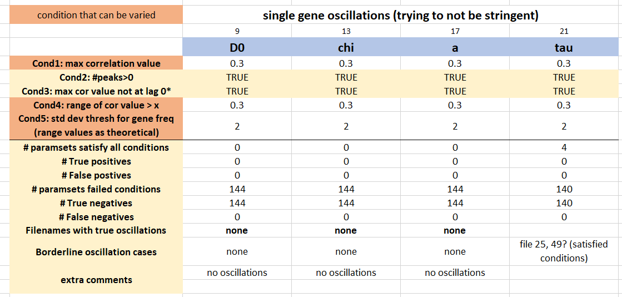

Slide 18
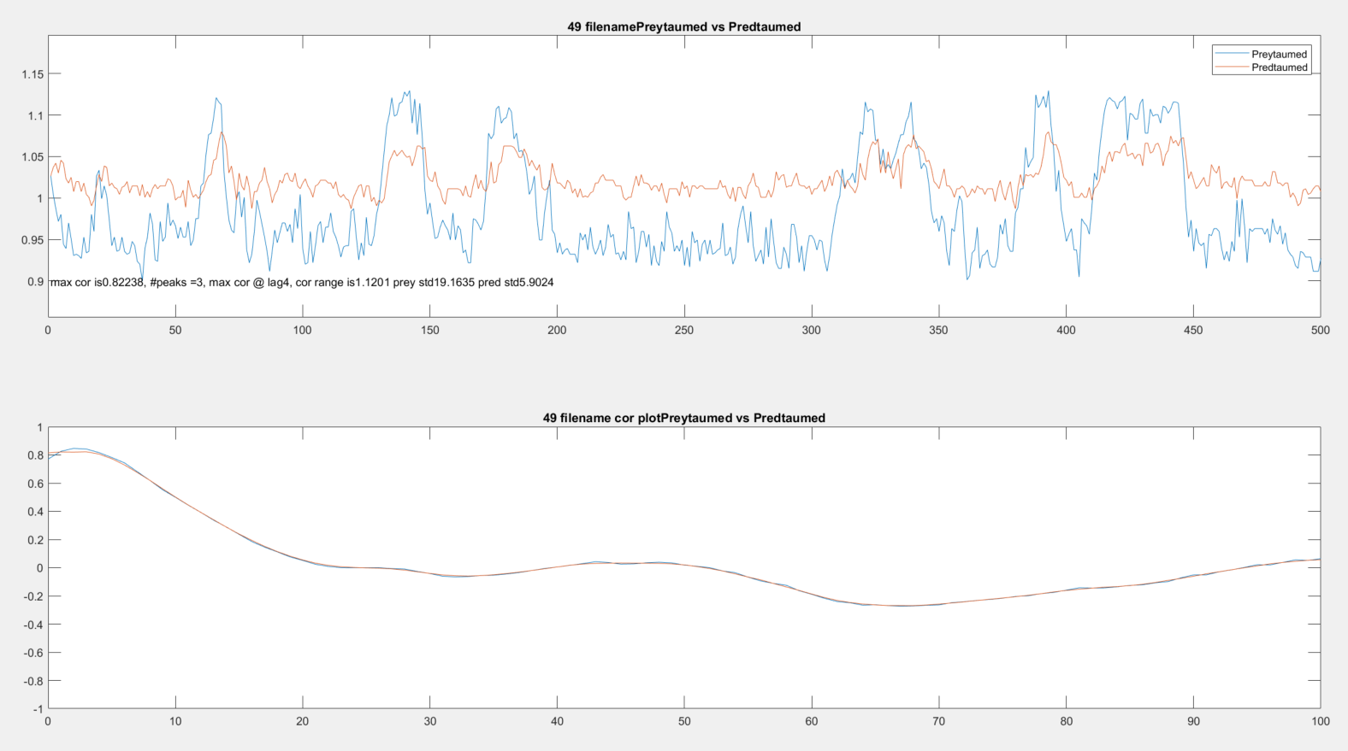
Borderline oscillations in tau

Slide 19
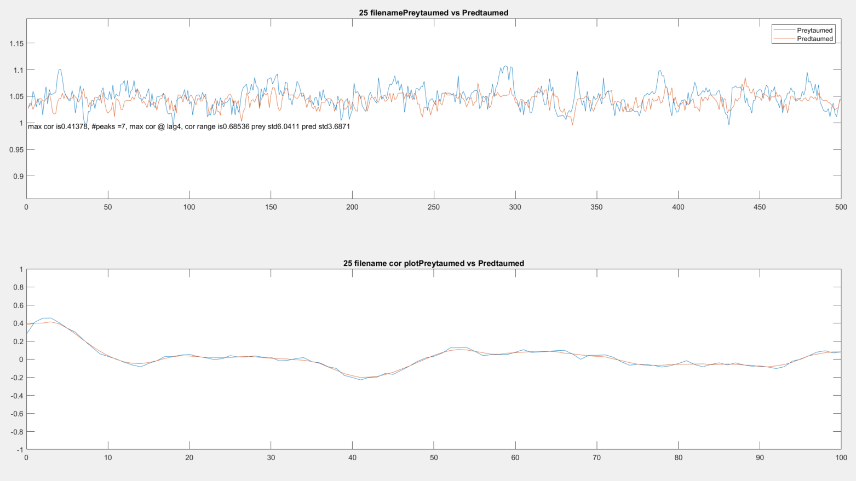
Borderline oscillations in tau

